Slide 1
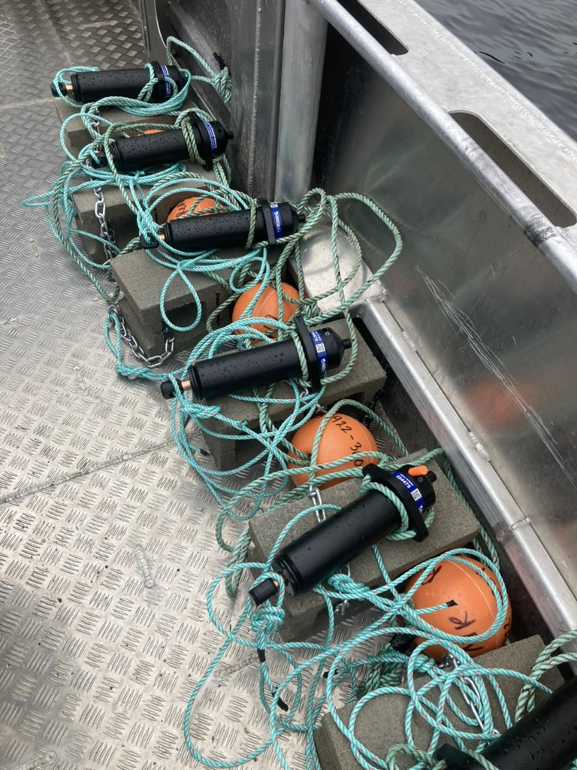



Estimating Detection Efficiency - Workshop
Benjamin L. Hlina, PhD
Great Lakes Institute of Research, University of Windsor

Slide 2
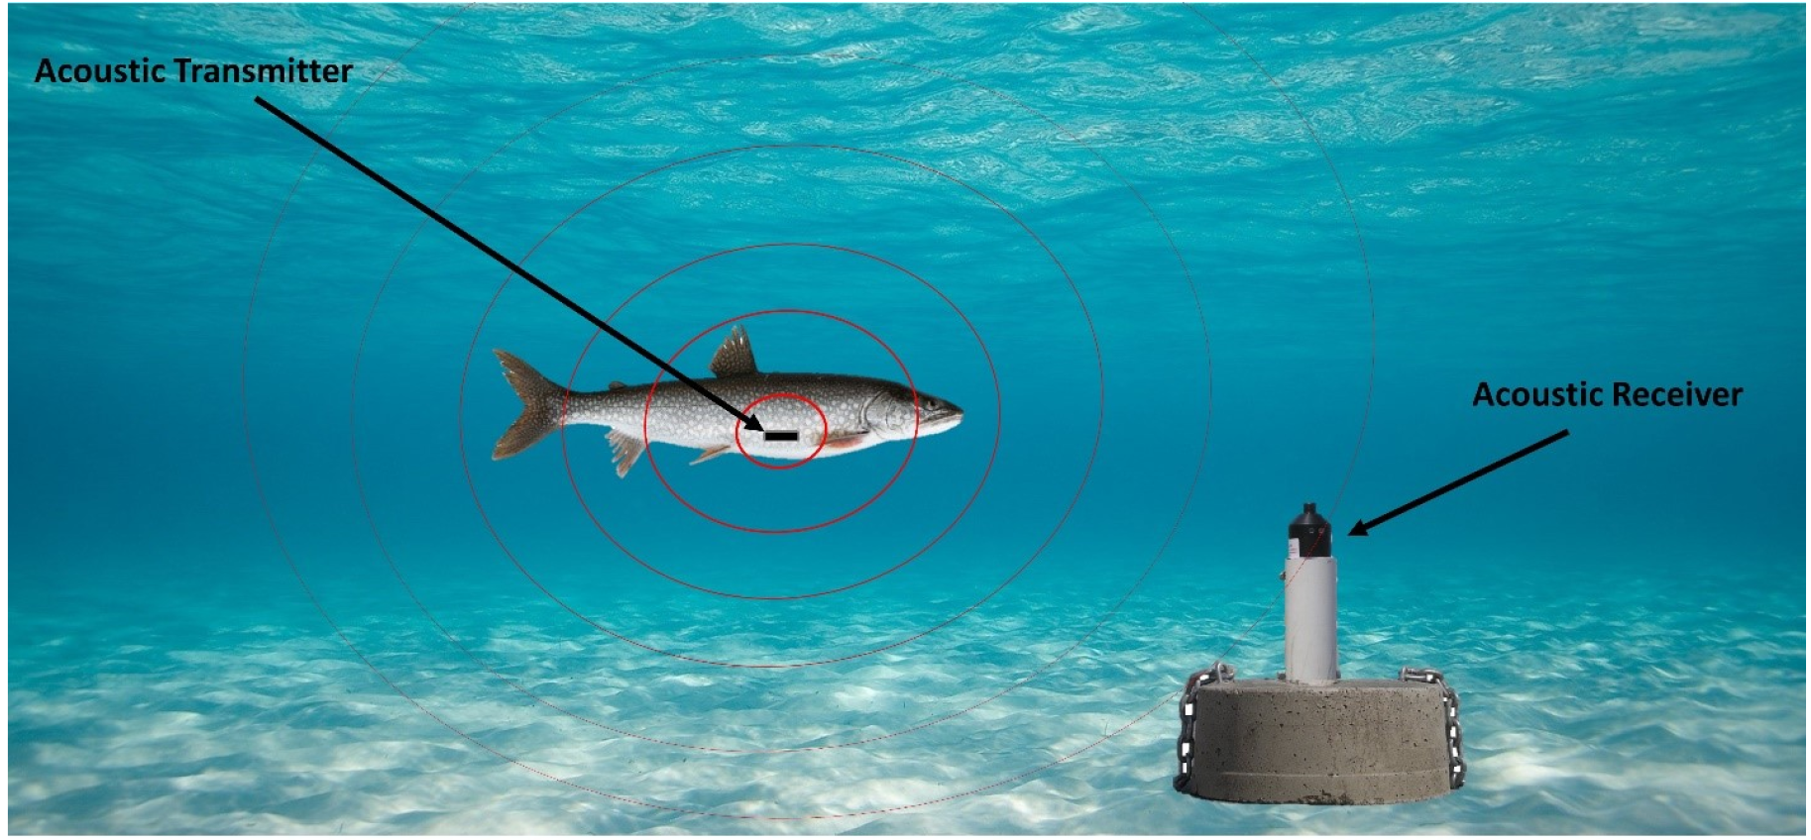
What is detection efficiency
Acoustic telemetry
Tags and receivers
Detection efficiency
How well can you hear?
How far can you hear?

Slide 3











Studies on Detection Efficiency

Slide 4
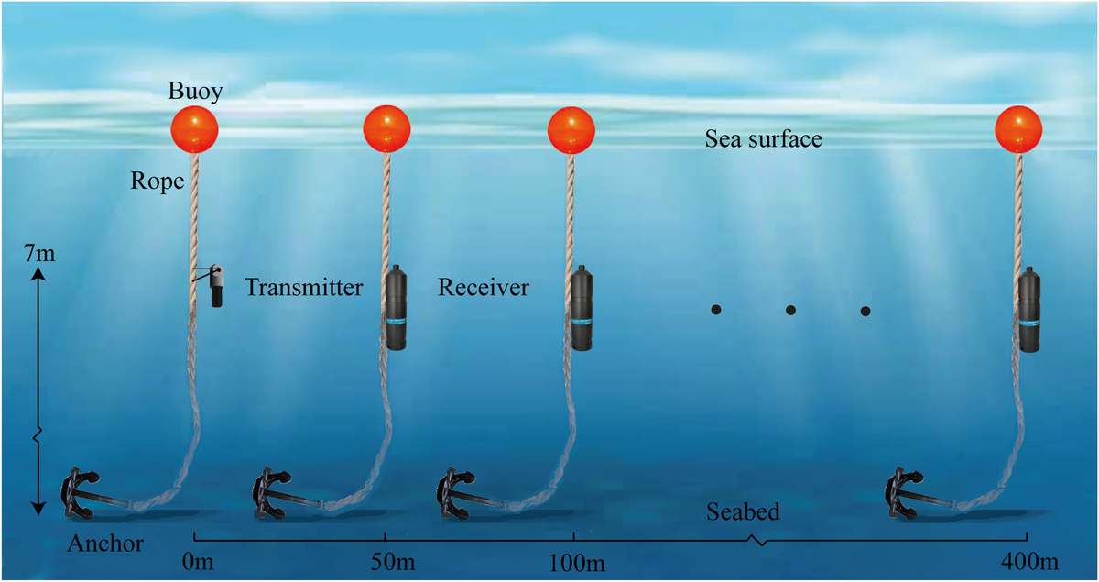
Why is Detection efficiency important
Understand anomalies and caveats of acoustic telemetry
Incorporate into analyzes
Lyu et al. 2023

Slide 5
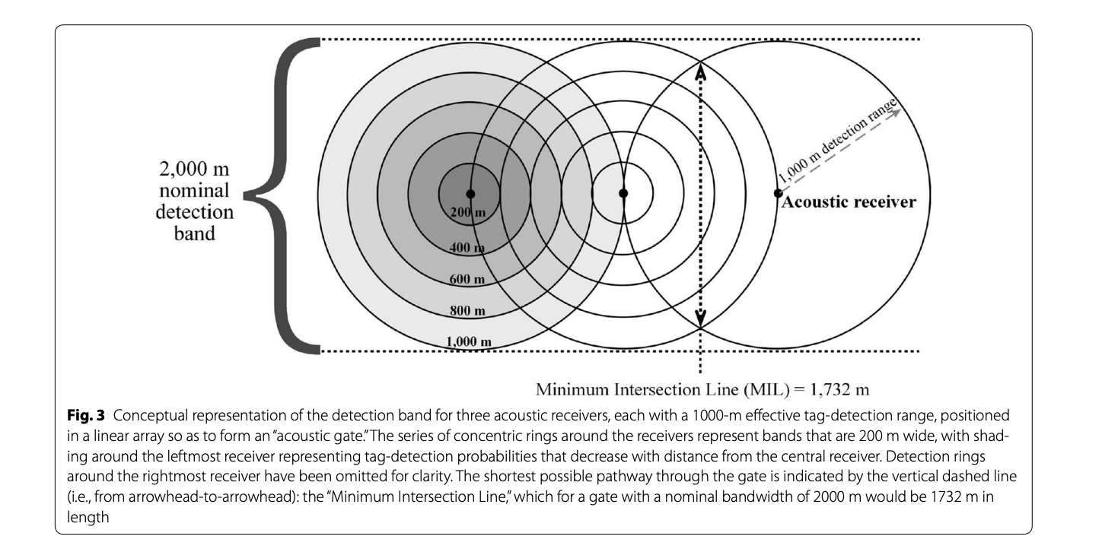
How do we Measure Efficiency
Continuously drift method
Stationary tag method
Loher et al. 2017

Slide 6
Workshop Material
GitHub link to workshop material is the following:
https://github.com/benjaminhlina/glatos-detection-efficiency
On this page is the following code which will download the R script, quarto docs, and compiled html for this workshop.
install.packages("usethis")
usethis::use_course("https://github.com/benjaminhlina/glatos-detection-efficiency/archive/refs/heads/main.zip")
You can also access soon access this vignette through {glatos} as well as at the folloing blog post https://blog.benjaminhlina.com/posts/post-with-code/detection-efficiency/

Slide 7
Stationary tag method overview
Deploy range transmitter at set distances (e.g., 100, 250, 500, and 750 m)
After 24 hr retrieve transmitters and receivers and download vrl files.
Import vrl files, receiver, and transmitter location data into Fathom Central or Innovasea website or R.
3a) Highly suggest doing multiple 24 hr deployments.
3b) Calculate the detection efficiency for each distance over the 24 hr.
Use preliminary range to estimate given distance using detection_range_model() from {glatos}.
Create redeployment locations at the distances the model estimates for the desired detection efficiency (e.g., 50%).
Redeploy our range transmitters for a given duration (e.g., 6 month, 1 year), to determine changes in detection efficiency over the study period.
Notes:
Pause for questions

Slide 8
Stationary tag method
Deploy range transmitter at set distances (e.g., 100, 250, 500, and 750 m) from the receiver you are wanting to range test for 24 hr. The range transmitters used in this vignette had a min delay of 840 s and max delay of 960 s but you could use continuous transmitters or transmitter with different delays.
After 24 hr retrieve transmitters and receivers and download vrl files.

Slide 9
Intial deployment
We will first load the desired packages. {dplyr}, {ggplot2} {mapview} {purrr} {sf}
{glatos} – remotes:: install_github(’benjaminhlina/glatos’, subdir = “detection_range_model”, build_vignettes = TRUE)
{ library(dplyr) library(ggplot2) library(glatos) library(mapview) library(purrr) library(sf) }

Slide 10
Example dataset
We will work with the example data set in {glatos} but the receiver deployment data will need to be in a table format or as sf object.
# get path to example receiver_locations file rec_file <- system.file("extdata", "sample_receivers.csv", package = "glatos" ) # note that code above is needed to find the example file # for real glatos data use your data. rcv <- read_glatos_receivers(rec_file) glimpse(rcv)

Slide 11
Convert to sf object
We will convert deployment data to a sf object and filter the data to only use the glatos array "OSC" for the example. You will not have to do the filtering when using your data but you will want to convert your receiver locations to a sf object and display using mapview().
rcv_osc_sf <- rcv %>% st_as_sf( coords = c("deploy_long", "deploy_lat"), crs = 4326 ) %>% filter(glatos_array %in% "OSC") # view in mapview mapview(rcv_osc_sf)

Slide 12
Example receiver
We will filter out station number 12 as example to create our intial deployment rings. We will also convert into UTMs so we can estimate distances away from the receiver in meters.
rcv_osc_sf_12 <- rcv_osc_sf %>% filter(station_no %in% 12) %>% st_transform(crs = 32617)

Slide 13
Create buffer rings at set distances
Next we will create buffer rings at our set distances away from the receiver. These distances are 100, 250, 500, and 750 but feel free to add more distances. If you add more distances you’re model predictions will likely be more accurate.
# first create a dataframe of distances to iterate over dists <- data.frame( distance = c(100, 250, 500, 750) ) # next we will split the dataframe by distance and iterate over it using map buffer_rings <- dists %>% split(.$distance) %>% map(~ st_buffer(dist = .x$distance, rcv_osc_sf_12)) %>% bind_rows(.id = "distance") %>% st_cast("LINESTRING") %>% dplyr::select(distance, glatos_array, station_no, ins_serial_no, geometry) # now view buffer rings mapview(rcv_osc_sf) + mapview(buffer_rings)
Now that we have the buffer rings we are going to pick 3 locations for each distance to potentially deploy range transmitters for 24 hr. We will then create an excel and gpx file of all the locations.

Slide 14
Viewing deployment locations
First we transform our buffer rings into spatial points, view them using mapview() and filter our the points we want. Then save as an excel and/or gpx file. buffer_rings_pts <- buffer_rings %>% st_cast("POINT") %>% mutate( id = 1:nrow(.) ) %>% dplyr::select(id, distance:geometry)
View them in {mapview}, this part will might take a little bit to select each point/figure out which ones you want.
mapview(rcv_osc_sf) + mapview(buffer_rings_pts)

Slide 15
Select locations for deployment
Then filter out the points we want, this will change depending on your study site and what locations you want. We will transform the projection back to WGS 84 as this is likely what your gps or sonar will want. We will also add in a few columns to conform to GLATOS and OTN data standards and rearrange the column order.
deploy_sites <- buffer_rings_pts %>% st_transform(crs = 4326) %>% filter(id %in% c( 4, 49, 155, 407, 456, 472, 671, 696, 720, 835, 876, 920 )) %>% rename( receiver_serial_no = ins_serial_no )

Slide 16
Select locations for deployment
deploy_sites <- deploy_sites %>% mutate( deploy_date_time = NA, deploy_lat = NA, deploy_long = NA, bottom_depth = NA, riser_length = NA, instrument_depth = NA, ins_model_number = NA, ins_serial_no = NA, transmitter = NA, transmitter_model = NA, deployed_by = NA, recovered = NA, recover_date_time = NA, recover_lat = NA, recover_long = NA, data_downloaded = NA, download_date_time = NA, comments = NA, expect_deploy_lat = st_coordinates(.)[, "Y"], expect_deploy_long = st_coordinates(.)[, "X"], comments = NA )

Slide 17
Select locations for deployment
deploy_sites <- deploy_sites %>% dplyr::select( id:receiver_serial_no, deploy_date_time:expect_deploy_long, geometry )

Slide 18
Export to excel and gpx formats
Then we will save as an excel and gpx file. To save as excel we will use {openxlsx}. You will notice that I don’t have it in the load packages area of this vignette. I have not placed it there for the purpose of how R builds vignettes but please add it to your load packages call. You will also need to replace "YOUR_FILE_PATH" with your file path for both saving as an excel and/or gpx file.
# save as excel openxlsx::write.xlsx(deploy_sites, "YOUR_FILE_PATH.xlsx") # save as gpx st_write(deploy_sites, "YOUR_FILE_PATH", driver = "GPX")
Now that you’ve created your excel and gpx file you can head out in the field to deploy your ranges transmitters for a given amount of time (e.g., 24 hr). After the time period you will retriever your receivers, download the vrl files and bring them into fathom central or the older detection range software. Once you export the csv you can move on to the next part of this vignette which is the analysis side.

Slide 19
Preliminary data download
Import vrl files and receiver and transmitter location data into Fathom Central. You can download the older version at the following Innovasea website. Alternatively, you can calculate preliminary detection efficiency in R.
To do this in R can either read in each vrl file into R using {glatos} or {rvdat} or create a vue database, bring in all vrl files, and export the detection file as a csv.
Next, add in a column that is the number of detections expect to be heard in 24 hr for the given delays. To do this we can take the number of seconds in a day, 86,400 s, divided by average delay which in this case is 900 s. This value, 96, means that we should hear a 96 times in a day if a receiver heard all detections.
det_summary <- dets %>% group_by(station, dets_expected, tag_serial_name) %>% summarise( dets_heard = n() ) %>% ungroup() %>% mutate( dets_eff = dets_heard / dets_expected )

Slide 20
Analysis
For the analysis you will want to start a new R script, hence why I have left load packages below.

Slide 21
Load packages and data
{ library(dplyr) library(ggplot2) library(glatos) library(mapview) library(purrr) library(sf) }
Next we will bring in our example data which is loaded with {glatos} but you will need to replace sample_detection_efficiency with your data frame either by loading the csv produced by Innovasea software or R. You can do this multiple ways, I prefer using readr::read_csv() but base R works perfectly fine.
# det_eff <- readr::read_csv("YOUR_DET_EFF.csv") # glimpse(det_eff) # view sample detection efficiency data sample_detection_efficiency glimpse(sample_detection_efficiency)

Slide 22
Calculate distances
Next we will use detection_range_model() to produce estimated distances for particular percentage (e.g., 50%). You will want to look through the help page for the function to make sure you’re setting up the model correctly.
Few additional tips:
With fewer data points a third order polynomial often fits the data better, however, this does not mean that neither a logit or probit model should not be assessed.
If a third order polynomial model is selected, the formula call can be in two different formats. The preferred and default format is y ~ -1 + x + I(x ^ 2) + I(x ^ 3) + offset(y-intercept), therefore, model_frame argument needs to be set "data_frame", which is the default, to properly extract parameters and determine distances from a receiver for the percentage of interest. If using the base::poly() in the formula such as, y ~ -1 + poly(x, 3, raw = TRUE) + offset(y-intercept), then, model_frame argument needs to be set to "matrix". Both formula formats have offset() which sets the y-intercept. The y-intercept needs to be set to 100, as x needs to equal 0 m from a receiver because you expect to hear a tag 100% of the time.
A third order polynomial will handle preliminary detection efficiency percentages (y variable) as whole numbers as the model is not bound by 0 and 1. While both logit and probit models have to use percentages as decimals as the models are bound by 0 and 1.

Slide 23
Using a third order polynomial
First, we will use a third order polynomial.
# third order polynomial: ave_percent is a whole number m <- detection_range_model( avg_percent ~ -1 + distance_m + I(distance_m^2) + I(distance_m^3) + offset(intercept), data = sample_detection_efficiency, percentage = c(10, 50, 90), link = "polynomial", model_frame = "data_frame" )

Slide 24
Using a logit model
Second, we will model the same data using a logit model. This model uses a logit link function using a logarithmic underlying error distribution.
# logit model: aver percent is in decimal form m1 <- detection_range_model(avg_percent_d ~ distance_m, data = sample_detection_efficiency, percentage = c(10, 50, 90), link = "logit", summary_stats = TRUE )

Slide 25
Using a probit model
Lastly, we can use a probit model. This model uses a probit link function using a Gaussian underlying error distribution.
m2 <- detection_range_model(avg_percent_d ~ distance_m, data = sample_detection_efficiency, percentage = c(10, 50, 90), link = "probit", summary_stats = TRUE )

Slide 26
Model Summmary
Considering the example data set is quite limited, you will notice each model performs differently, especially, the third-order polynomial which fits better than the logit and probit models. Each model predicts that at 50% detections will be heard at roughly 365-370 m away from the receiver.

Slide 27
Plot all three models
We will first plot the third order polynomial model first because there is a scaling issue as the third order polynomial is bound by 0-100 while the probit and logit models are bound by 0-1.
ggplot() + geom_point( data = sample_detection_efficiency, aes(x = distance_m, y = avg_percent), size = 3 ) + geom_hline(yintercept = c(10, 50, 90), linetype = 2) + geom_smooth( data = sample_detection_efficiency, aes(x = distance_m, y = avg_percent), method = "lm", linewidth = 1, formula = y ~ -1 + x + I(x^2) + I(x^3), method.args = list(offset = sample_detection_efficiency$intercept), colour = "#8da0cb", se = FALSE ) + scale_y_continuous(breaks = seq(0, 100, 20)) + theme_bw(base_size = 15) + theme( panel.grid = element_blank() ) + labs( x = "Distance (m)", y = "Detection efficency (%)" )

Slide 28
Plot all three models
I have added in the dotted lines at where the 10, 50, and 90% detection efficiency occurs. We will then plot the logit and probit models next.
ggplot() + geom_point( data = sample_detection_efficiency, aes(x = distance_m, y = avg_percent_d), size = 3 ) + geom_hline(yintercept = c(0.10, 0.50, 0.90), linetype = 2) + geom_smooth( data = sample_detection_efficiency, aes(x = distance_m, y = avg_percent_d), method = "glm", linewidth = 1, method.args = list(family = binomial(link = "logit")), colour = "#66c2a5", se = FALSE ) + geom_smooth( data = sample_detection_efficiency, aes(x = distance_m, y = avg_percent_d), method = "glm", linewidth = 1, method.args = list(family = binomial(link = "probit")), colour = "#fc8d62", se = FALSE ) + scale_y_continuous(breaks = seq(0, 1, 0.20)) + theme_bw(base_size = 15) + theme( panel.grid = element_blank() ) + labs( x = "Distance (m)", y = "Detection efficency (%)" )

Slide 29
Reployment - Create buffer ring
The first step in redeployment of the range transmitters is to calculate a buffer ring at the given distance estimated from the models (e.g., 370 m). We will use steps very similar to the deployment steps.
redeploy_loc <- st_buffer(dist = 370, rcv_osc_sf_12) %>% st_cast("LINESTRING") %>% mutate( distance = 370 ) %>% dplyr::select(distance, glatos_array, station_no, ins_serial_no, geometry) # now view redeployment rings mapview(rcv_osc_sf) + mapview(redeploy_loc)

Slide 30
Creating redployment locations
Now that we have the redeployment ring we are going to pick 3 locations to potentially deploy range transmitters for the study period. We will then create an excel and gpx file of all the locations.
First we transform our buffer rings into spatial points, view them using mapview() and filter our the points we want. Then save as an execl and/or gpx file.
redeploy_loc_pts <- redeploy_loc %>% st_cast("POINT") %>% mutate( id = 1:nrow(.) ) %>% dplyr::select(id, distance:geometry)
View them in mapview, this part will might take a little bit to select each point/figure out which ones you want.
mapview(rcv_osc_sf) + mapview(redeploy_loc_pts)

Slide 31
Select redeployment location
Then filter out the points we want, this will change depending on your study site and what locations you want. We will transform the projection back to WGS 84 as this is likely what your gps or sonar will want.
We will also add in a few columns to conform to GLATOS and OTN data standards and rearrange the column order.
redeploy_sites <- buffer_rings_pts %>% st_transform(crs = 4326) %>% filter(id %in% c(116, 161, 201)) %>% rename( receiver_serial_no = ins_serial_no )

Slide 32
Select redeployment location
Then filter out the points we want, this will change depending on your study site and what locations you want. We will transform the projection back to WGS 84 as this is likely what your gps or sonar will want. We will also add in a few columns to conform to GLATOS and OTN data standards and rearrange the column order.
redeploy_sites <- redeploy_sites %>% mutate( deploy_date_time = NA, deploy_lat = NA, deploy_long = NA, bottom_depth = NA, riser_length = NA, instrument_depth = NA, ins_model_number = NA, ins_serial_no = NA, transmitter = NA, transmitter_model = NA, deployed_by = NA, recovered = NA, recover_date_time = NA, recover_lat = NA, recover_long = NA, data_downloaded = NA, download_date_time = NA, comments = NA, expect_deploy_lat = st_coordinates(.)[, "Y"], expect_deploy_long = st_coordinates(.)[, "X"], comments = NA )

Slide 33
Select redeployment location
Lastly we will select the columns we need.
redeploy_sites <- redeploy_sites %>% dplyr::select( id:receiver_serial_no, deploy_date_time:expect_deploy_long, geometry )

Slide 34
Export as an excel and gpx formats
Then we will save as an excel and gpx file. To save as excel we will use {openxlsx}. You will notice that I don’t have it in the load packages area of this vignette. I have not placed it there for the purpose of how R builds vignettes but please add it to your load packages call. You will also need to replace "YOUR_FILE_PATH" with your file path for both saving as an excel and/or gpx file.
# save as excel openxlsx::write.xlsx(redeploy_sites, "YOUR_FILE_PATH.xlsx") # save as gpx st_write(redeploy_sites, "YOUR_FILE_PATH", driver = "GPX")
Now that you’ve created your excel and gpx file you can head out in the field to deploy your ranges transmitters for your study period. After the time period you will retriever your receivers, download the vrl files and create detection csvs. From there you can filter your range transmitters, calculate the number of heard in a day (e.g., 38) and divide it by the number you’re suppose to hear (e.g., 96), to get your daily detection efficiency. You can then model changes in daily detection efficiency over the course of the study. Congratulations you have now successfully calculated your receiver detection range over your study time period.

Slide 35
Questions
Benjamin.Hlina@gmail.com

